Slide 1
Session 7– GitHub and Tools
What’s being used out in the industry
Oct. 5 2023

Slide 2
Topics for Today
Announcements
GitHub
Tools
Next Sessions – Great Topics

Slide 3
Announcements
MSBA Student Ambassador Application – Opens soon!
INFORMS student organization

Slide 4
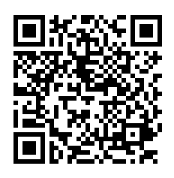
Networking 101 Pre-Survey
Networking 101 Event during Professional Development Class
Thursday, October 12
12:30pm
North Room, IMU

Slide 5
Tools of the Industry

Slide 6
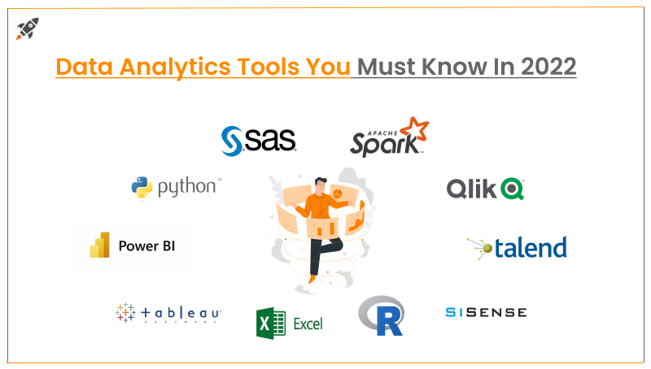
Tools in the Field
https://blog.digitalogy.co/best-data-analytics-tools/

Slide 7
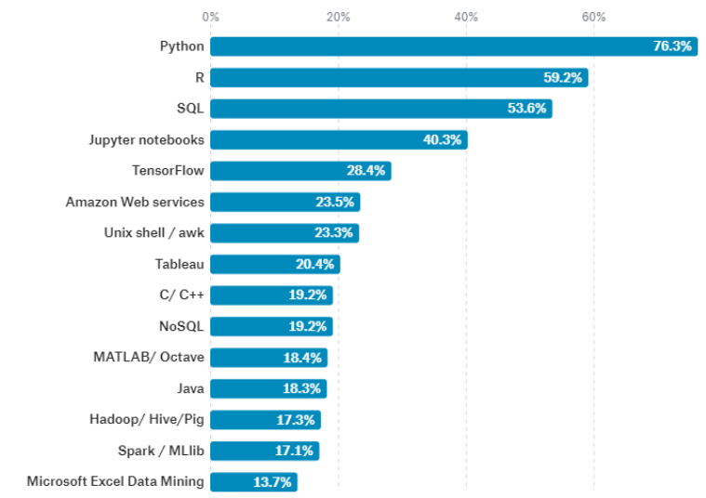
Top 15 Tools
https://blog.revolutionanalytics.com/2017/10/survey-of-kagglers.html

Slide 8
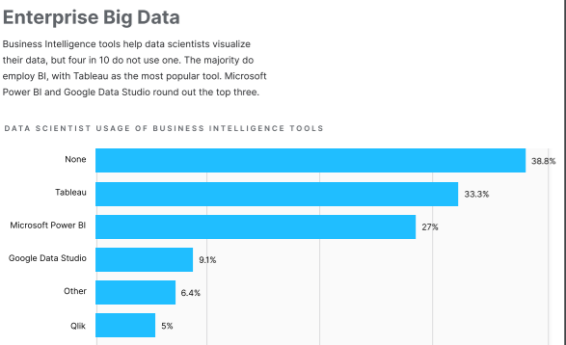
Business Intelligence Tools

Slide 9
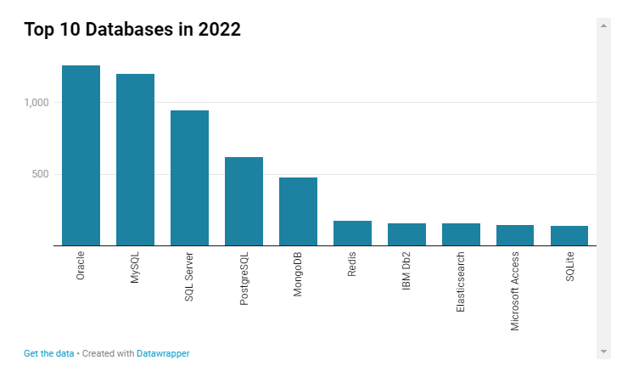
Popular Databases
https://towardsdatascience.com/top-databases-to-use-in-2022-what-is-the-right-database-for-your-use-case-bb8d3f183b21

Slide 10
Popular Tools
Power BI
Alteryx
Trello or Asana
GitHub
Amazon Web Services (AWS)
Agile (Methodology)

Slide 11
Group Exercise
Power BI
Alteryx
Trello
GitHub
AWS
Agile
Provide a high-level summary of the tool.
How is this tool used in the analytics industry?
Why would you use this tool?
Does this tool interface with other tools or software?
What types of jobs or roles use this tool?

Slide 12
GitHub

Slide 13

What is GitHub
A really cute cat octopus?
Open-source repository for storing software code
Allows tracking of iterations (version control)
Collaboration tool
AND…A GREAT WAY TO SHOWCASE YOUR SKILLS TO EMPLOYERS

Slide 14
Getting Started
GitHub and Git Basics Video
Learn more through:
LinkedIn Learning – Free to U of Iowa students
https://skills.github.com/ - Learn how to use GitHub with short interactive activities
Upload source code and project samples
Add GitHub public link to your resume

Slide 15
GitHub Page Samples
Create a repository
Kris Arens: https://github.com/kristinearens
Create a Website
Kris’ Sample: https://kaarens.github.io/testpage/
Canny Li Page: https://mobius21.github.io/markdown-portfolio/
Zach McDaniel: https://zachmcdaniel.github.io/

Slide 16
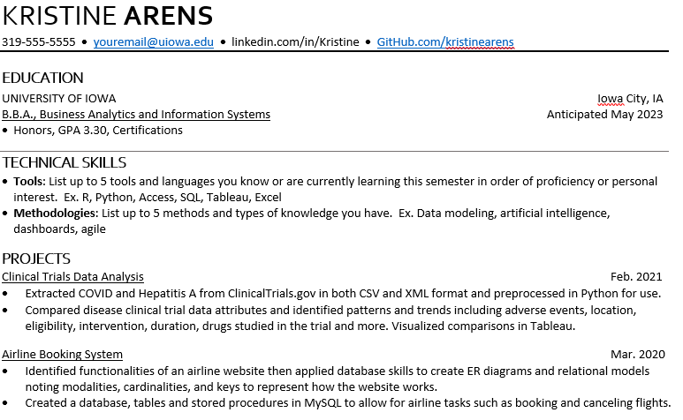
GitHub on Resumes
Showcase your work
Match repository to projects
Provide:
Code examples
Presentations
Data Analysis

Slide 17
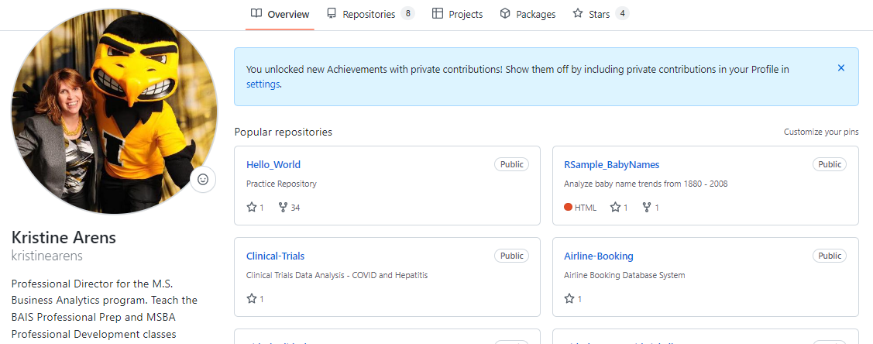
Let’s Take a Look
https://github.com/kristinearens

Slide 18
Assignment

Slide 19
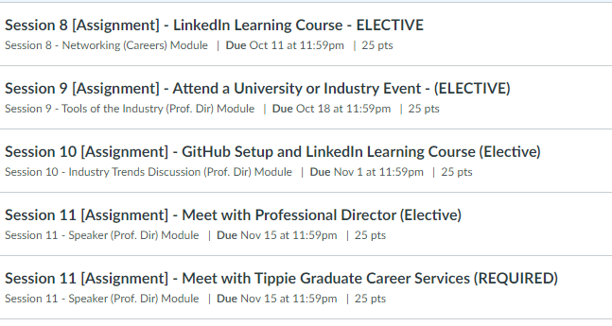
Assignment Options Coming Up
REQUIRED: Meet with Career Services – Schedule TODAY!
Electives – Remember you need at least 250 for an A in this class
Attendance Points added soon

Slide 20
Upcoming Sessions
Oct. 12 - Career Services - This will be the last career services session. The topic of class is Networking. This is a joint class with Finance and will be held in the IMU North Room
Oct. 19 - Speaker - MSBA alum, Jason WoodsonLinks to an external site. will be here to discuss how he manages and processes data in his job.
Oct. 26 - No Class
Nov. 2 - Industry Trends Discussion
Nov. 9 - No Class
Nov. 16 - Panel of speakers from State Farm Insurance - All MSBA alums who work at the same place, but do VERY different work.

